Slide 1
Chapter 4: Neural Networks

Slide 2
Outline
4.1 Neuron
4.2 Neural Network
4.3 Feedforward Neural Network
4.4 Back Propagation Algorithm

Slide 3
4.1 Neuron

Slide 4

Biological neuron
A single nerve cell has only two states: excitation and inhibition.
Notes:
树突接收信号，汇聚到细胞体（包含阈值）
兴奋/抑制
兴奋之后通过轴突传给其他神经元

Slide 5
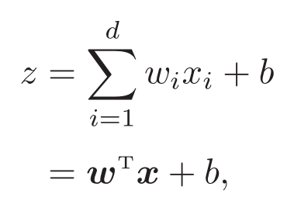
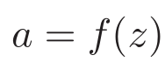
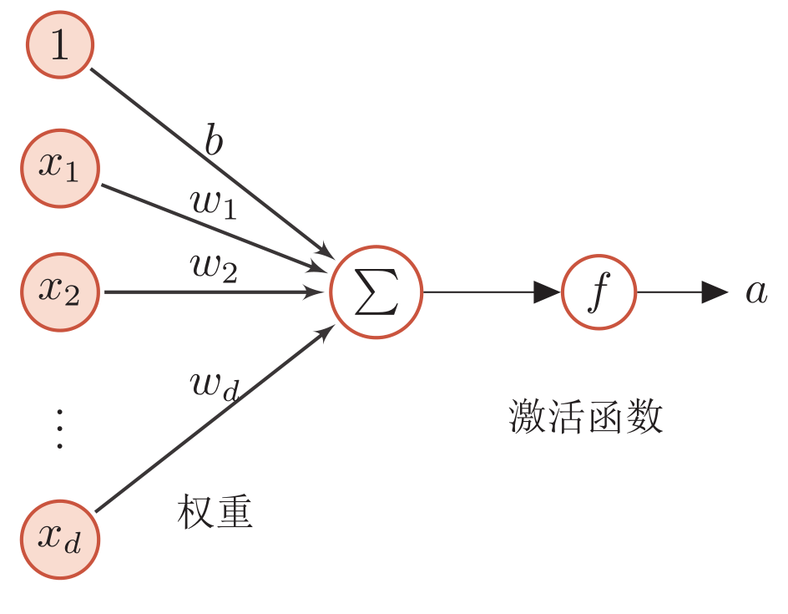
Artificial neuron
Net input
Activity value
This is a simple linear model!

Slide 6
Properties of activation function
A nonlinear function that is continuous and differentiable.
Derivable activation function can directly use numerical optimization method to learn network parameters.
Activation function and its derivative should be simple.
beneficial to improving the network computing efficiency.
The range of the derivative of the activation function should be in an appropriate interval.
Neither too big nor too small, otherwise it will affect the efficiency and stability of training.
Monotonically increasing
Maybe not. But on the whole, it is on the rise.
Notes:
神经元：收集信息，映射（激活函数）
a=f(z)

Slide 7
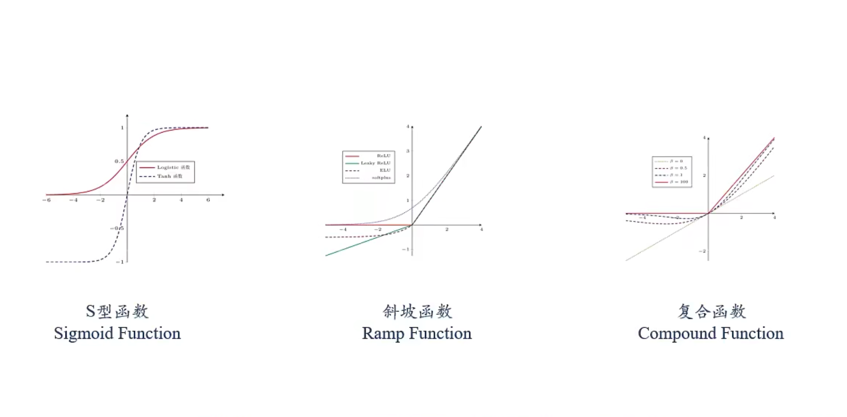
Commonly used activation function

Slide 8
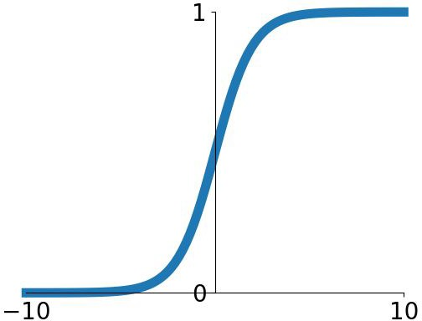
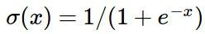
S-type: Sigmoid function
Squashes numbers to range [0,1]
Historically popular since they have nice interpretation as a saturating “firing rate” of a neuron
Sigmoid

Slide 9
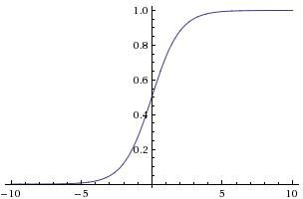
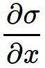
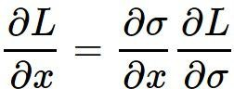
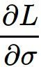
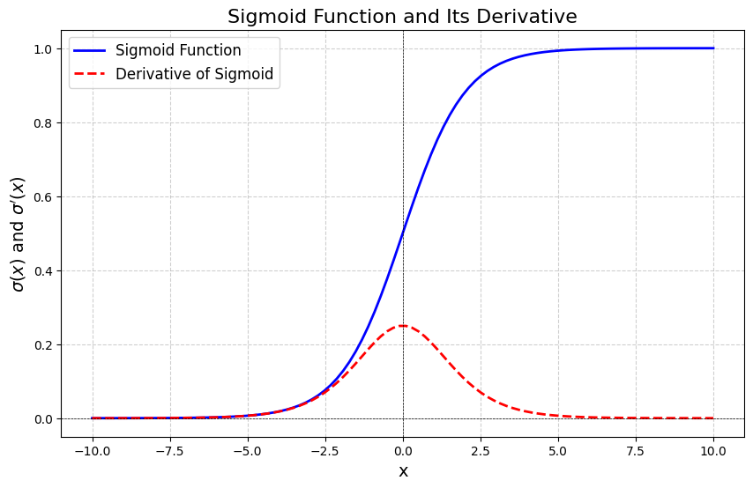
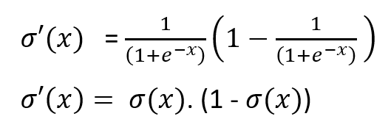

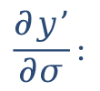
Problem: Saturated neurons “kill” the gradients
x
sigmoid gate
What happens when x = -10? What happens when x = 0?
What happens when x = 10?
$$\frac{∂y’}{∂σ}:$$
$$\frac{∂L}{∂w}=\frac{∂L}{∂y’}\frac{∂y’}{∂σ}\frac{∂σ}{∂w}$$

Slide 10
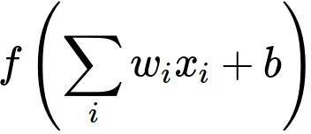

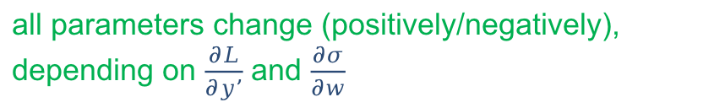
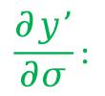
Problem: Sigmoid outputs are not zero-centered
Consider what happens when the input to a neuron is always positive...
allowed gradient update directions
allowed gradient update directions
zig zag path
What can we say about the gradients on w? Always all positive or all negative :(
(this is also why you want zero-mean data!)
hypothetical optimal w vector
The output of non-zero centralization will make the input of neurons in the next layer bias shift, and further slow down the convergence speed of gradient descent.
$$\frac{∂L}{∂w}=\frac{∂L}{∂y’}\frac{∂y’}{∂σ}\frac{∂σ}{∂w}$$
$$\frac{∂y’}{∂σ}:$$
all parameters change (positively/negatively), depending on $\frac{∂L}{∂y’}$ and $\frac{∂σ}{∂w}$
always > 0

Slide 11
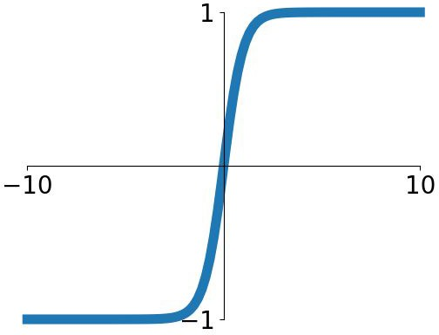
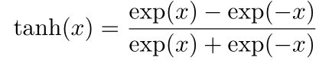
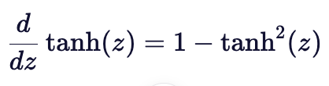
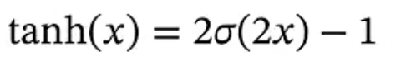
tanh(x)
Squashes numbers to range [-1,1]
zero centered (nice)
still kills gradients when saturated :(

Slide 12
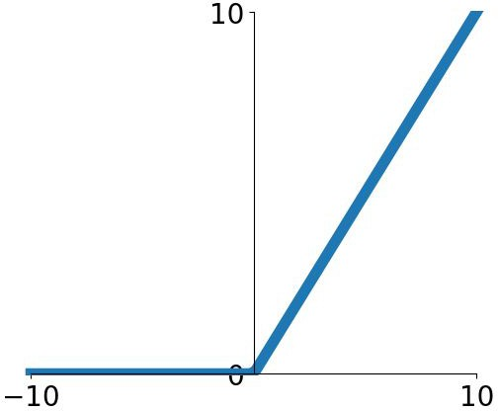
Common activation function: ramp function
- Computes f(x) = max(0,x)
Does not saturate (in +region)
Very computationally efficient
Converges much faster than sigmoid/tanh in practice (e.g. 6x)
Actually more biologically plausible
than sigmoid
Not zero-centered output
An annoyance:
hint: what is the gradient when x < 0?
ReLU
(Rectified Linear Unit)

Slide 13
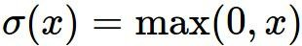
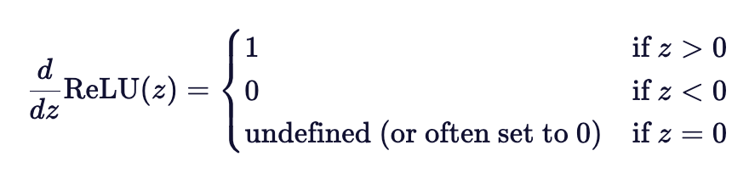
Problem
x
ReLU
gate
What happens when x = -10? What happens when x = 0?
What happens when x = 10?
Notes:
Derivative at x=0 is undefined, but ususally defined as 0 in training.

Slide 14


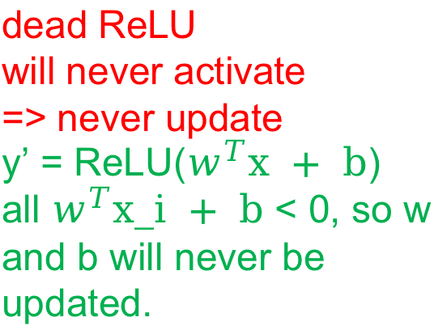
Dead ReLU
active ReLU
DATA CLOUD
dead ReLU
will never activate
=> never update
y’ = ReLU($w^{T}x + b$)
all $w^{T}x_i + b$ < 0, so w and b will never be updated.
=> people like to initialize ReLU neurons with slightly positive biases (e.g. 0.01)
Notes:
Causes of Dead ReLU:
Large negative biases: If a neuron’s weights and biases evolve in such a way that the input to the ReLU function is consistently negative, the neuron will output zero for all forward passes.
Improper weight initialization: If the weights are initialized poorly, it can cause some neurons to receive consistently negative values during training, leading to dead ReLUs early in the training process.
High learning rates: Large updates to the weights during backpropagation can push the inputs to the ReLU function into negative values, making those neurons more likely to "die."

Slide 15
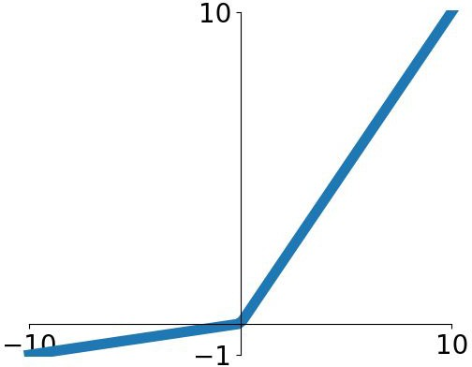
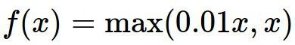
Leaky ReLU
Does not saturate
Computationally efficient
Converges much faster than sigmoid/tanh in practice! (e.g. 6x)
will not “die”.
Leaky ReLU

Slide 16
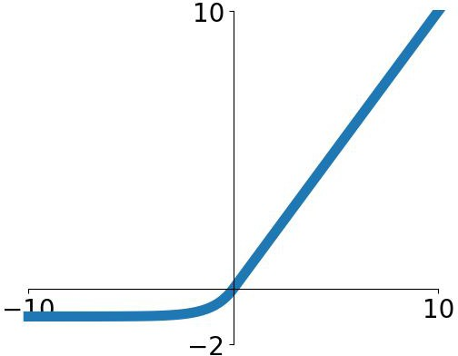
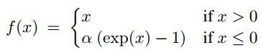
Exponential Linear Units (ELU)
All benefits of ReLU
Closer to zero mean outputs
Negative saturation regime compared with Leaky ReLU adds some robustness to noise
Computation requires exp()

Slide 17
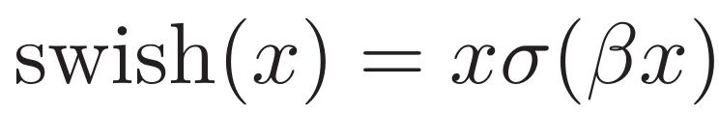
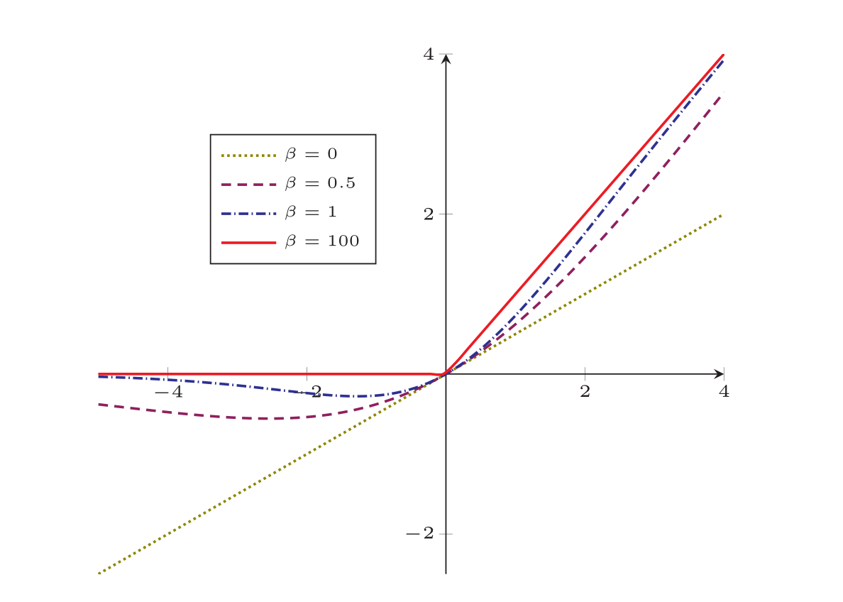
Common activation function: composite function
Swich function：a Self-gated activation function
Notes:
用sigmoid函数近似一个gate
参数\beta用于控制允许通过的信息的多少

Slide 18
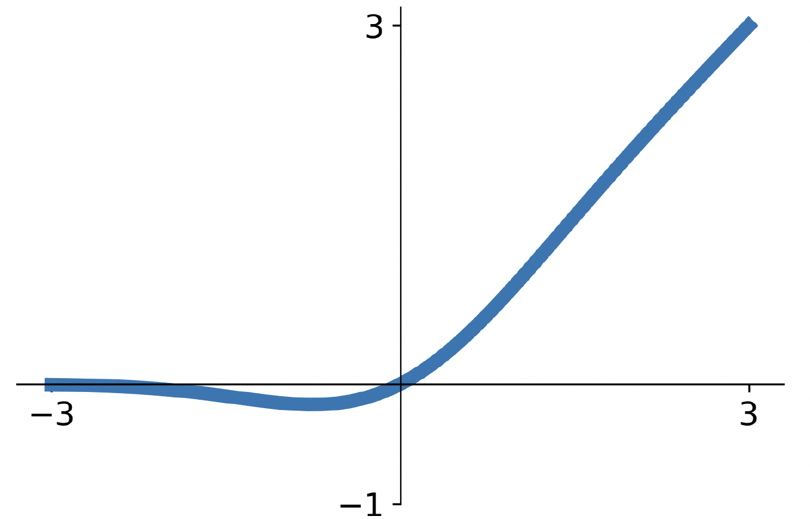
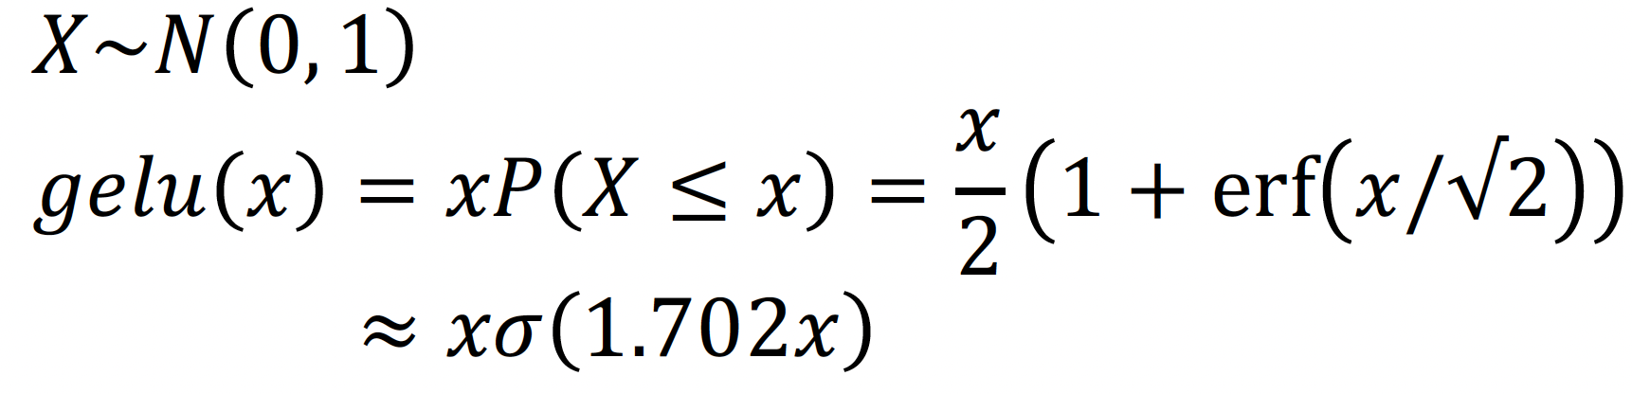
GeLU: Gaussian error linear unit
Idea: Multiply input by 0 or 1 at random; large values more likely to be multiplied by 1, small values more likely to be multiplied by 0
(data-dependent dropout)
Take expectation over randomness
Very common in Transformers (BERT, GPT, ViT)

Slide 19
In practice:
Don’t think too hard. Just use ReLU
Try out Leaky ReLU / ELU / GELU if you need to squeeze that last 0.1%
Don’t use sigmoid or tanh
Some recent architectures use GeLU instead of ReLU, but the gains are minimal
Dosovitskiy et al, “An Image is Worth 16x16 Words: Transformers for Image Recognition at Scale”, ICLR 2021 Liu et al, “A ConvNet for the 2020s”, arXiv 2022

Slide 20
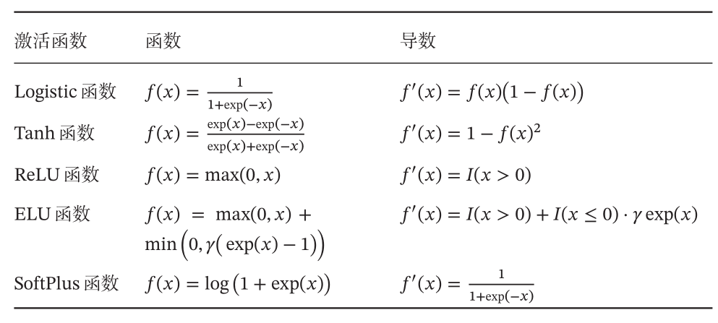
Common activation functions and their derivatives

Slide 21
6.2 Neural Network

Slide 22
Artificial Neural Network (ANN)
ANN is mainly composed of a large number of neurons and their directed connections. So consider three aspects:
Activation rules of neurons
Mainly refers to the mapping relationship between the input and output of neurons, which is generally a nonlinear function.
Topological structure of network
The connection between different neurons.
Learning Algorithm
The parameters of neural network are learned by training data.

Slide 23
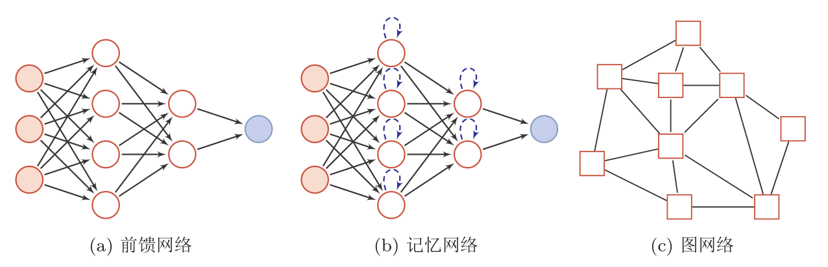
Network structure
ANN is composed of neuron model, and this information processing network composed of many neurons has a parallel distribution structure.
A circular node represents a neuron, and a square node represents a group of neurons.
Notes:
记忆网络：与状态有关
图网络：连接由图定义，每个节点是一组神经元。

Slide 24
Graph Neural Networks (GNNs)
Used for graph data structures, such as knowledge maps, social networks, molecular networks, etc.
Graph Convolutional Networks (GCN)
Kipf, T. N., & Welling, M. (2016). Semi-supervised classification with graph convolutional networks. arXiv preprint arXiv:1609.02907.
Graph Attention Networks
Veličković, P., Cucurull, G., Casanova, A., Romero, A., Lio, P., & Bengio, Y. (2017). Graph attention networks. arXiv preprint arXiv:1710.10903.
GNN with mini-batch training
Hamilton, Will, Zhitao Ying, and Jure Leskovec. "Inductive representation learning on large graphs." Advances in neural information processing systems 30 (2017).

Slide 25
Neural network (NN)
NN was originally used as a main connectionist model.
In the late 1980s, one of the most popular connectionist models was the Parallel Distributed Processing (PDP) network, which had three main characteristics:
1）Information representation is distributed (non-local)
2）Memory and knowledge are stored in the connections between units
3）Learn new knowledge by gradually changing the connection strength between units.
After introducing error back propagation to improve its learning ability, neural networks are increasingly applied to various machine learning tasks.

Slide 26
6.3 Feedforward Neural Network

Slide 27
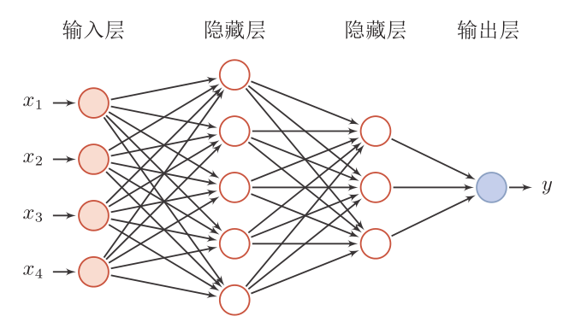
Network structure
Feedforward NN (fully connected NN, multilayer perceptron)
Each neuron belongs to different layers, and there is no connection in the layers.
The neurons between two adjacent layers are connected in pairs.
There is no feedback, and the signal propagates unidirectionally from input to output layer, a directed acyclic graph.

Slide 28
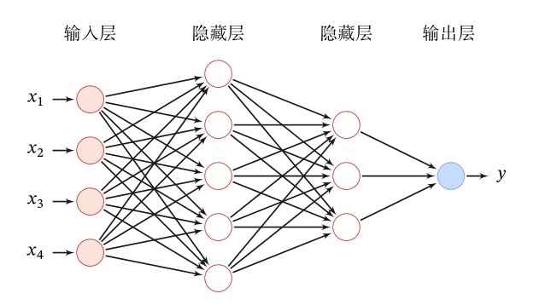
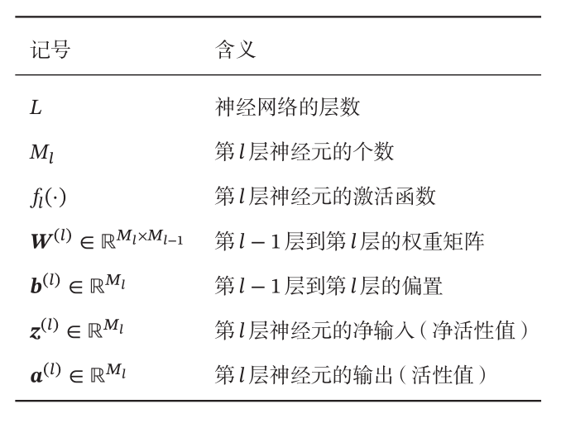
Feedforward Neural Network
Given a feedforward neural network, the following notations are used to describe such a network:

Slide 29
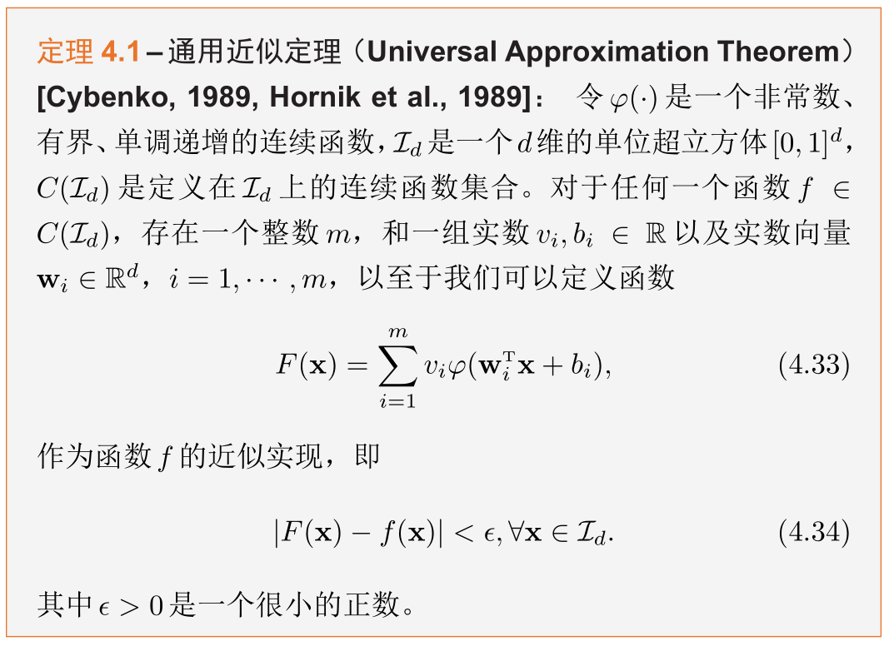
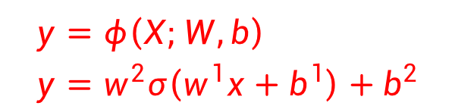
Universal Approximation Theorem
$$y=φ\left(X;W,b\right) \\ y=w^{2}σ\left(w^{1}x+b^{1}\right)+b^{2}$$
Thinking: Can a two-layer ReLU network simulate any bounded closed set function?
According to the universal approximation theorem, a feedforward neural network consisting of a linear output layer and at least one hidden layer using the "squeezing" property can approximate any bounded closed set function defined in real number space with arbitrary accuracy as long as the number of neurons in the hidden layer is sufficient.
Notes:
神经网络的通用近似性质也被证明对于其它类型的激活函数，比如ReLU，也都是适用的。

Slide 30
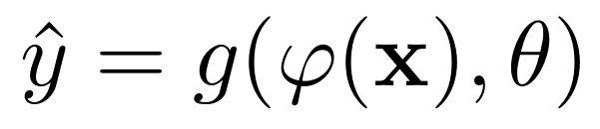
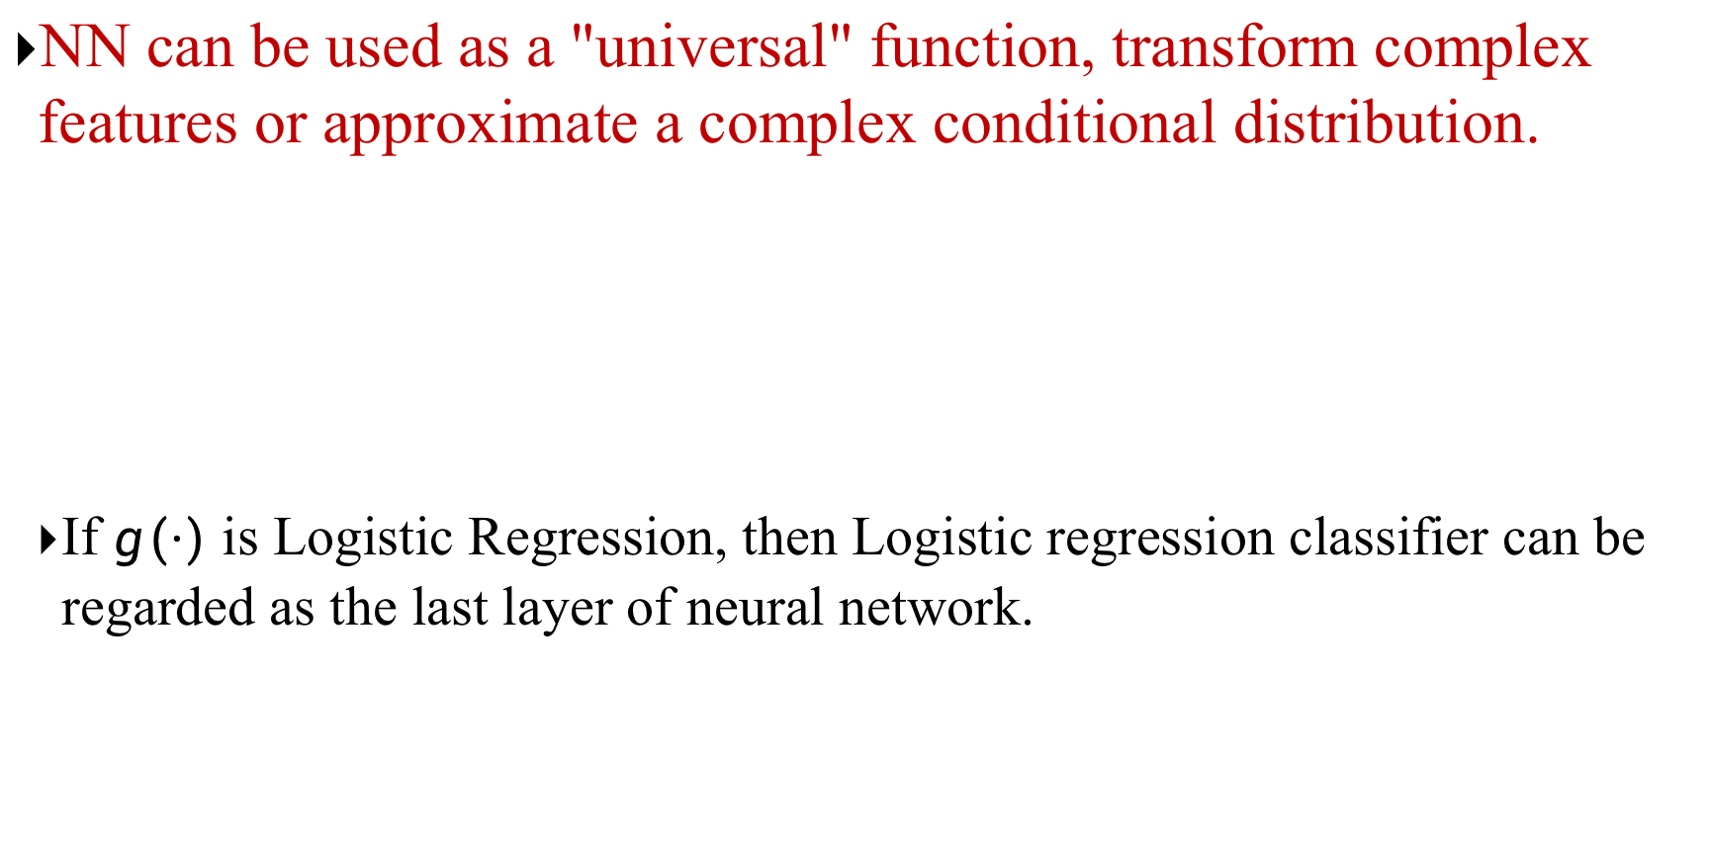
Applied to Machine Learning
NN can be used as a "universal" function, transform complex features or approximate a complex conditional distribution.
If $g(⋅)$ is Logistic Regression, then Logistic regression classifier can be regarded as the last layer of neural network.
classifier
Neural networks
Notes:
特征抽取

Slide 31
Remarks on the Universal Approximation Theorem
In practice, we use deep NN (consists of multiple hidden layers), instead of a shallow but wide (1 hidden layer with many neurons) NN. Why?
1. Parameter efficiency.
Consider a NN with 100,100 neurons. Suppose we want to build a NN to do binary classification, if your input is 500 dimensional, how many parameters do we need? For simplicity, we ignore the bias term.
- Shallow but wide (a NN with 1 hidden layer): 500 * 100,100 + 100,100 * 1= 50,150,100
- Deep but thin (e.g. a NN with 10 hidden layer): (500 * 100) + (100 * 100) * 10 + 100 * 1= 150,100
2. Better performance.
Notes:
神经网络的通用近似性质也被证明对于其它类型的激活函数，比如ReLU，也都是适用的。

Slide 32
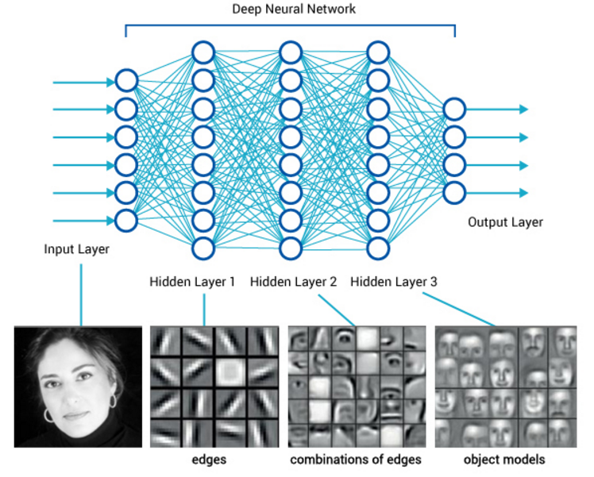
Deep Feedforward Neural Network

Slide 33
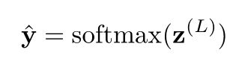
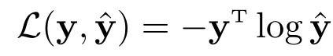
Parameter Learning
For multi-classification problems
If Softmax regression classifier is used, it is equivalent to setting C neurons in the last layer, and its output is conditional probability of each class after being normalized by Softmax function.
Using the cross entropy loss function, for the sample (x,y), the loss function is
Notes:
Softmax可看作一种特殊的激活函数。
y\in{0,1}^C

Slide 34
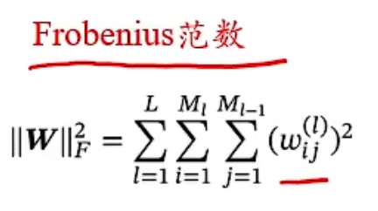
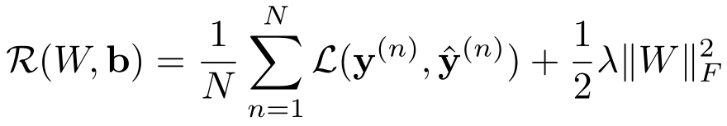
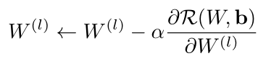
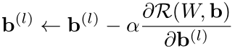
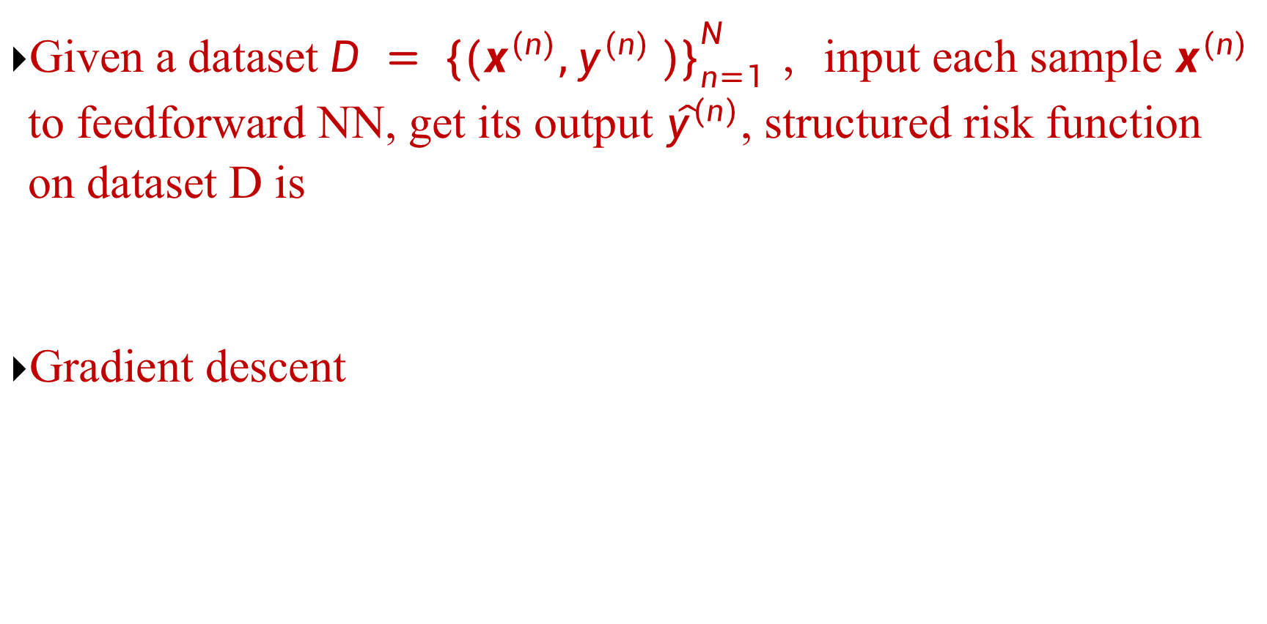
Parameter Learning
Given a dataset $D = {\{(x^{(n)},y^{(n)} )\}}_{n=1}^{N }$ ，input each sample $x^{(n)}$ to feedforward NN, get its output ${\hat{y}}^{(n)}$, structured risk function on dataset D is
Gradient descent

Slide 35
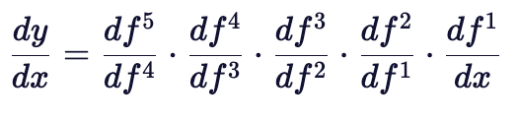
How to calculate the gradient?
Neural network is a complex compound function.
Chain rule**(important!)
Back propagation algorithm**(important!)
An efficient method designed according to the characteristics of feedforward network
$y=f5(f4(f3(f2(f1\left(x\right)))))$ → $\frac{∂y}{∂x}=\frac{∂f1}{∂x}\frac{∂f2}{∂f1}\frac{∂f3}{∂f2}\frac{∂f4}{∂f3}\frac{∂f5}{∂f4}$
We prefer to write from outside → inside

Slide 36
6.4 Back Propagation

Slide 37


Matrix Calculus
An expression of multivariate calculus: using matrices and vectors to represent partial derivatives of each component of the dependent variable w.r.t each component of the independent variable.
Denominator Layout (Column Vector)
Partial derivative of scalar with respect to vector
Partial derivative of vector with respect to vector

Slide 38


Chain rule
Chain Rule is a common method to find the derivative of compound function in calculus.

Slide 39

Compute Gradient

Slide 40







Compute Gradient
$$ℝ^{1×M_{l}}$$
Error term
Here $m^{(l)}$ refers to the number of neurons in the $l$-th layer, namely $m_{l}$

Slide 41








Compute
$$∈ℝ^{M_{l}×M_{l+1}}$$
$$∈ℝ^{M_{l}×M_{l}}$$
Back propagation
$$∈ℝ^{M_{l}}$$

Slide 42


Backpropagation: a simple example
Reference: Stanford CS231n

Slide 43






Backpropagation: a simple example
e.g. x = -2, y = 5, z = -4
1
Want:
Reference: Stanford CS231n

Slide 44

Backpropagation: a simple example
e.g. x = -2, y = 5, z = -4
1
3
Want:
Reference: Stanford CS231n

Slide 45

Backpropagation: a simple example
e.g. x = -2, y = 5, z = -4
-4
1
3
Want:
Reference: Stanford CS231n

Slide 46



Backpropagation: a simple example
e.g. x = -2, y = 5, z = -4
-4
-4
1
3
Chain rule:
Want:
Upstream gradient
Local gradient
Reference: Stanford CS231n

Slide 47

Backpropagation: a simple example
-4
e.g. x = -2, y = 5, z = -4
-4
-4
1
3
Chain rule:
Want:
Upstream gradient
Local gradient
Reference: Stanford CS231n

Slide 48







Backpropagation: a simple example
“local gradient”
f
“Downstream gradients”
“Upstream
gradient”

Slide 49


Another example

Slide 50
Another example

Slide 51


Another example

Slide 52
Another example

Slide 53

Another example
Upstream gradient
Local gradient

Slide 54
Another example

Slide 55
Another example
Upstream gradient
Local gradient

Slide 56
Another example

Slide 57
Another example
Upstream gradient
Local gradient

Slide 58
Another example

Slide 59
Another example
Upstream gradient
Local gradient

Slide 60
Another example

Slide 61
Another example
[upstream gradient] x [local gradient] [0.2] x [1] = 0.2
[0.2] x [1] = 0.2 (both inputs!)

Slide 62
Another example

Slide 63

Another example
[upstream gradient] x [local gradient] w0: [0.2] x [-1] = -0.2
x0: [0.2] x [2] = 0.4

Slide 64

Another example
Computational graph representation may not be unique. Choose one where local gradients at each node can be easily expressed!
Sigmoid function
Sigmoid
Sigmoid local gradient:

Slide 65
Another example
Computational graph representation may not be unique. Choose one where local gradients at each node can be easily expressed!
Sigmoid function
Sigmoid
[upstream gradient] x [local gradient] [1.00] x [(1 - 1/(1+e⁻¹)) (1/(1+e⁻¹))] = 0.2
Sigmoid local gradient:

Slide 66
Another example
Computational graph representation may not be unique. Choose one where local gradients at each node can be easily expressed!
Sigmoid function
Sigmoid
[upstream gradient] x [local gradient] [1.00] x [(1 - 0.73) (0.73)] = 0.2
Sigmoid local gradient:

Slide 67
Patterns in gradient flow
add gate: gradient distributor 3
mul gate: “swap multiplier” 2
2
4
7
5*3=15
3
6
+
×
2
5
2
copy gate: gradient adder
7
7
4+2=6
2*5=10
max gate: gradient router 4
4
7
0
5
5
max
9
2
9

Slide 68



Backprop implementation
Forward pass: Compute output
Backward pass: Compute grads

Slide 69
Backprop implementation
Forward pass: Compute output
Base case

Slide 70
Backprop implementation
Forward pass: Compute output
Sigmoid

Slide 71
Backprop implementation
Forward pass: Compute output
Add gate

Slide 72
Backprop implementation
Forward pass: Compute output
Add gate

Slide 73
Backprop implementation
Forward pass: Compute output
Multiply gate

Slide 74
Backprop implementation
Forward pass: Compute output
Multiply gate

Slide 75
So far: backprop with scalars
What about vector-valued functions?

Slide 76








Recap: Vector derivatives
Scalar to Scalar
Vector to Scalar
Vector to Vector
Regular derivative:
Derivative is Gradient:
Derivative is Jacobian:
If x changes by a small amount, how much will y change?
For each element of x, if it changes by a small amount then how much will y change?
For each element of x, if it changes by a small amount then how much will each element of y change?

Slide 77

Backprop with Vectors
Loss L still a scalar!
f

Slide 78
Backprop with Vectors
D_{x}
Loss L still a scalar!
D_{z}
f
D_{y}

Slide 79
Backprop with Vectors
D_{x}
Loss L still a scalar!
D_{z}
f
D_{y}
“Upstream gradient”

Slide 80
Backprop with Vectors
D_{x}
Loss L still a scalar!
D_{z}
f
D_{z}
D_{y}
“Upstream gradient” For each element of z, how much does it influence L?

Slide 81


Backprop with Vectors
D_{x}
Loss L still a scalar!
“local gradients”
D_{z}
f
“Downstream
gradients”
D_{z}
D_{y}
“Upstream gradient” For each element of z, how much does it influence L?

Slide 82
Backprop with Vectors
D_{x}
Loss L still a scalar!
“local gradients”
[D_{x} x D_{z}]
f
[D_{y} x D_{z}]
Jacobian matrices
D_{z}
“Downstream
gradients”
D_{z}
D_{y}
“Upstream gradient” For each element of z, how much does it influence L?

Slide 83
Backprop with Vectors
D_{x}
Loss L still a scalar!
“local gradients”
[D_{x} x D_{z}]
f
D_{x}
D_{z}
“Downstream
gradients”
Matrix-vector multiply
[D x D ]
D_{z}
D_{y}
y z
Jacobian matrices
“Upstream gradient” For each element of z, how much does it influence L?
D_{y}

Slide 84


Gradients of variables wrt loss have same dims as the original variable
Loss L still a scalar!
D_{x}
D_{x}
D_{z}
f
D_{z}
D_{y}
“Upstream gradient” For each element of z, how much does it influence L?
D_{y}

Slide 85
Backprop with Vectors
4D input x:
4D output z:
[ 1 ]
[ -2 ]
[ 3 ]
[ -1 ]
f(x) = max(0,x)
(elementwise)
[ 1 ]
[ 0 ]
[ 3 ]
[ 0 ]
Jacobian dz/dx [ 1 0 0 0 ]
[ 0 0 0 0 ]
[ 0 0 1 0 ]
4D dL/dz:
[ 4 ]
[ -1 ]
[ 5 ]
Upstream gradient
[ 0 0 0 0 ]
[ 9 ]

Slide 86
Backprop with Vectors
4D input x:
4D output z:
[ 1 ]
[ -2 ]
[ 3 ]
[ -1 ]
f(x) = max(0,x)
(elementwise)
[ 1 ]
[ 0 ]
[ 3 ]
[ 0 ]
Jacobian is sparse: off-diagonal entries always zero! Never explicitly form Jacobian -- instead use implicit multiplication
4D dL/dx: [ 4 ]
[ 0 ]
[ 5 ]
[ 0 ]
[dz/dx] [dL/dz] [ 1 0 0 0 ] [ 4 ]
[ 0 0 0 0 ] [ -1 ]
[ 0 0 1 0 ] [ 5 ]
[ 0 0 0 0 ] [ 9 ]
4D dL/dz:
[ 4 ]
[ -1 ]
[ 5 ]
[ 9 ]
Upstream gradient

Slide 87

Backprop with Vectors
4D input x:
4D output z:
[ 1 ]
[ -2 ]
[ 3 ]
[ -1 ]
f(x) = max(0,x)
(elementwise)
[ 1 ]
[ 0 ]
[ 3 ]
[ 0 ]
Jacobian is sparse: off-diagonal entries always zero! Never explicitly form Jacobian -- instead use implicit multiplication
4D dL/dx: [ 4 ]
[ 0 ]
[ 5 ]
[ 0 ]
[dz/dx] [dL/dz]
4D dL/dz:
[ 4 ]
[ -1 ]
[ 5 ]
[ 9 ]
z
Upstream gradient

Slide 88
Backprop with Matrices (or Tensors)
Loss L still a scalar!
[D_{x}×M_{x}]
dL/dx always has the same shape as x!
[D_{z}×M_{z}]
f
Jacobian matrices
Matrix-vector multiply
[D_{y}×M_{y}]

Slide 89


Backprop with Matrices (or Tensors)
Loss L still a scalar!
[D_{x}×M_{x}]
[D_{x}×M_{x}]
dL/dx always has the same shape as x!
[D_{z}×M_{z}]
f
Jacobian matrices
“Downstream
gradients”
Matrix-vector multiply
[D_{y}×M_{y}]
[D_{z}×M_{z}]
“Upstream gradient” For each element of z, how much does it influence L?
[D_{y}×M_{y}]

Slide 90

Backprop with Matrices (or Tensors)
Loss L still a scalar!
[D_{x}×M_{x}]
[D_{x}×M_{x}]
dL/dx always has the same shape as x!
[D_{z}×M_{z}]
“local gradients”
“Downstream
gradients”
Matrix-vector multiply
[D_{y}×M_{y}]
[D_{y}×M_{y}]
[D_{z}×M_{z}]
“Upstream gradient” For each element of z, how much does it influence L?
Jacobian matrices
For each element of y, how much does it influence each element of z?

Slide 91
Backprop with Matrices
Loss L still a scalar!
[D_{x}×M_{x}]
[D_{x}×M_{x}]
dL/dx always has the same shape as x!
“local gradients”
[(D_{x}×M_{x})×(D_{z}×M_{z})]
[D_{z}×M_{z}]
“Downstream
gradients”
Matrix-vector multiply
[(D_{y}×M_{y})×(D_{z}×M_{z})]
[D_{y}×M_{y}]
[D_{z}×M_{z}]
Jacobian matrices
“Upstream gradient” For each element of z, how much does it influence L?
[D_{y}×M_{y}]
For each element of y, how much does it influence each element of z?

Slide 92

Backprop with Matrices
y: [N×M]
[13 9 -2 -6 ]
[ 5 2 17 1 ]
x: [N×D]
Matrix Multiply
[ 2 1 -3 ]
[ -3 4 2 ]
dL/dy: [N×M] [ 2 3 -3 9 ]
[ -8 1 4 6 ]
w: [D×M]
[ | 3 | 2 | 1 -1]
[ | 2 | 1 | 3 2]
[ | 3 | 2 | 1 -2]
Jacobians: dy/dx: [(N×D)×(N×M)]
dy/dw: [(D×M)×(N×M)]
For a neural net we may have N=64, D=M=4096
Each Jacobian takes ~256 GB of memory! Must work with them implicitly!

Slide 93
Backprop with Matrices
y: [N×M]
[13 9 -2 -6 ]
[ 5 2 17 1 ]
x: [N×D]
Matrix Multiply
[ 2 1 -3 ]
[ -3 4 2 ]
dL/dy: [N×M] [ 2 3 -3 9 ]
[ -8 1 4 6 ]
w: [D×M]
[ 3 2 1 -1]
[ 2 1 3 2]
[ 3 2 1 -2]
Q: What parts of y are affected by one element of x?

Slide 94



Backprop with Matrices
y: [N×M]
[13 9 -2 -6 ]
[ 5 2 17 1 ]
x: [N×D]
Matrix Multiply
[ 2 1 -3 ]
[ -3 4 2 ]
dL/dy: [N×M] [ 2 3 -3 9 ]
[ -8 1 4 6 ]
w: [D×M]
[ 3 2 1 -1]
[ 2 1 3 2]
[ 3 2 1 -2]
Q: What parts of y are affected by one element of x?
A: affects the whole row

Slide 95

Backprop with Matrices
y: [N×M]
[13 9 -2 -6 ]
[ 5 2 17 1 ]
x: [N×D]
Matrix Multiply
[ 2 1 -3 ]
[ -3 4 2 ]
dL/dy: [N×M] [ 2 3 -3 9 ]
[ -8 1 4 6 ]
w: [D×M]
[ 3 2 1 -1]
[ 2 1 3 2]
[ 3 2 1 -2]
Q: What parts of y are affected by one element of x?
Q: How much
does
affect ?
A: affects the whole row

Slide 96


Backprop with Matrices
y: [N×M]
[13 9 -2 -6 ]
[ 5 2 17 1 ]
x: [N×D]
Matrix Multiply
[ 2 1 -3 ]
[ -3 4 2 ]
dL/dy: [N×M] [ 2 3 -3 9 ]
[ -8 1 4 6 ]
w: [D×M]
[ 3 2 1 -1]
[ 2 1 3 2]
[ 3 2 1 -2]
Q: What parts of y are affected by one element of x?
Q: How much
does
affect ?
A: affects the
A:
whole row

Slide 97

Backprop with Matrices
y: [N×M]
[13 9 -2 -6 ]
[ 5 2 17 1 ]
x: [N×D]
Matrix Multiply
[ 2 1 -3 ]
[ -3 4 2 ]
dL/dy: [N×M] [ 2 3 -3 9 ]
[ -8 1 4 6 ]
w: [D×M]
[ 3 2 1 -1]
[ 2 1 3 2]
[ 3 2 1 -2]
Q: What parts of y are affected by one element of x?
Q: How much
does
affect ?
A: affects the
A:
[N×D] [N×M] [M×D]
whole row

Slide 98

Backprop with Matrices
y: [N×M]
[13 9 -2 -6 ]
[ 5 2 17 1 ]
x: [N×D]
Matrix Multiply
[ 2 1 -3 ]
[ -3 4 2 ]
dL/dy: [N×M] [ 2 3 -3 9 ]
[ -8 1 4 6 ]
w: [D×M]
[ 3 2 1 -1]
[ 2 1 3 2]
[ 3 2 1 -2]
By similar logic:
[N×D] [N×M] [M×D]
[D×M] [D×N] [N×M]
These formulas are easy to remember: they are the only way to make shapes match up!

